Slide 1
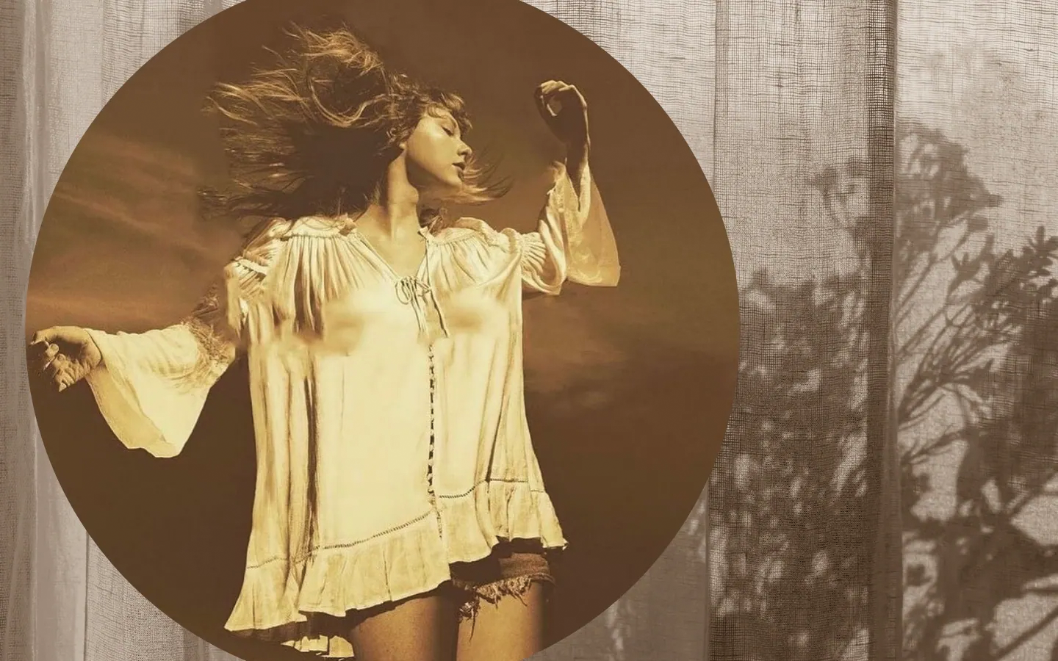

Fearless Tour Taylor Swift
Presenter: Supawadee Phakdee

Slide 2

About Taylor Swift
Was born in West Reading, Pennsylvania
Singer-songwriter
Pop and country music
Becomes famous in 2004

Slide 3
Target Audience
Young Adults: 18-25 years old
Majority are female
Love Pop & Country music
Primarily within the US

Slide 4
Logo

Slide 5

Typographic Ad

Slide 6



Magazines for typographic ad
Fall Winter Spring

Slide 7
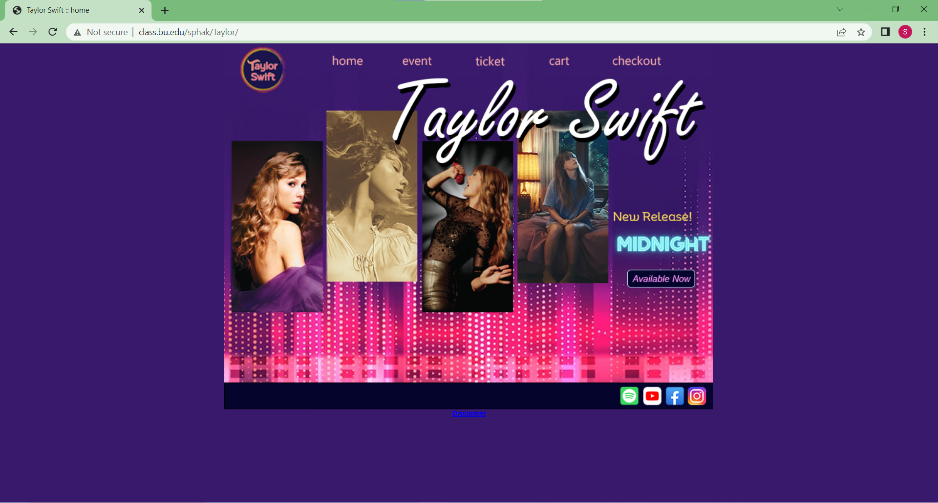
Micro-Site

Slide 8

Web Banners

Slide 9
Web Banners

Slide 10

Web Banners

Slide 11
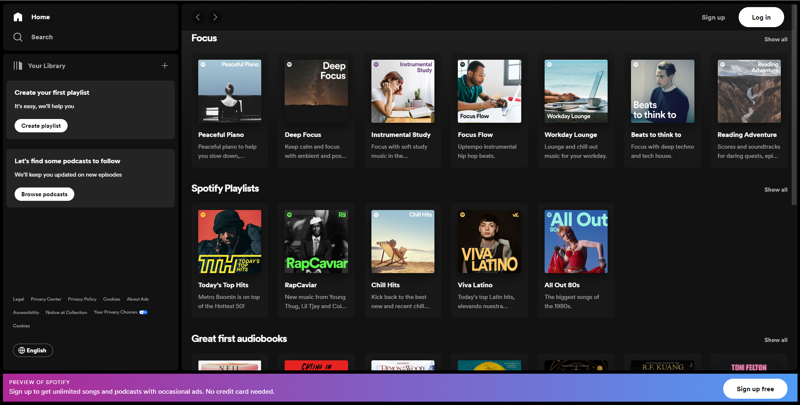
Websites for Web Banners
Spotify-gif

Slide 12
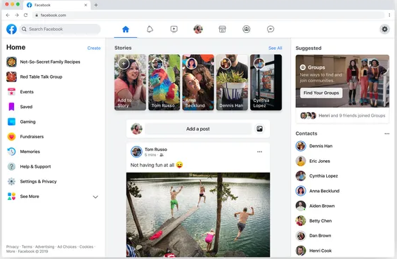
Websites for Web Banners
Facebook-animate

Slide 13
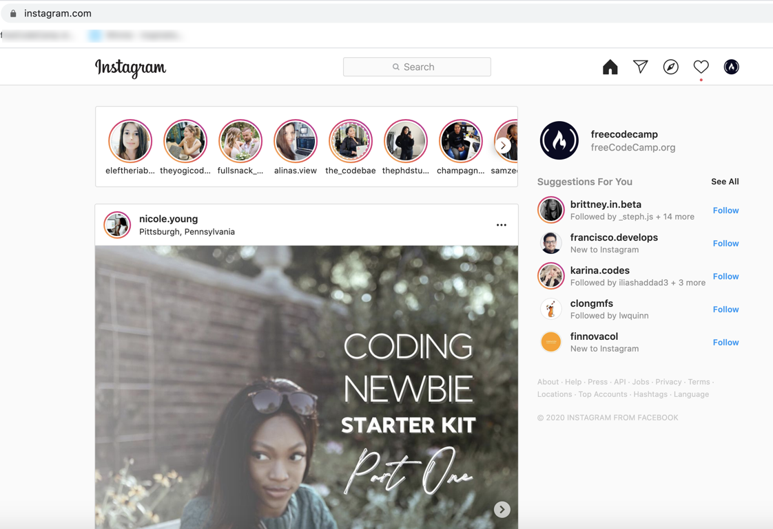
Websites for Web Banners
Instagram-static

Slide 14

Album Art

Slide 15

Album Art

Slide 16
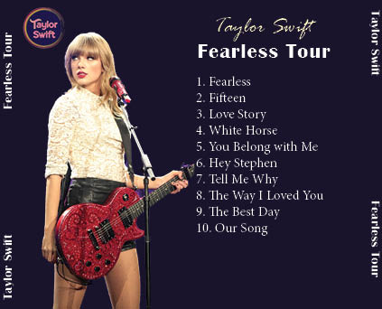
Album Art

Slide 17
Thank you! Q&A ?

